Slide 1

React Components - Deep Dive
Lists and Keys, Component Lifecycle, CSS Modules
SoftUni Team
Technical Trainers
Software University
http://softuni.bg

Slide 2

Table of Contents
Lists & Keys
Component Lifecycle
Higher-Order-Components
CSS Modules
Fetching Data

Slide 3
Have a Question?
sli.do #js-web

Slide 4




Lists and Keys
Identify items, Reconciliation

Slide 5
Lists and Keys
Using map() we can build collections of elements and include them in JSX using {}
Keys should be given to the elements inside the array to give the elements a stable identity
Keys help React identify which items have changed, are added, or are removed

Slide 6

Lists and Keys
Using map() to take an array of numbers and double their values
Rendering Multiple Components
const numbers = [1, 2, 3, 4, 5];
const doubled = numbers.map((number) => number * 2);
console.log(doubled); // [2, 4, 6, 8, 10]
const numbers = [1, 2, 3, 4, 5];
const listItems = numbers.map((number) =>
<li>{number}</li>
);

Slide 7
Basic List Component
Basic List Component looks like
function NumberList(props) {
const numbers = props.numbers;
const listItems = numbers.map((number) =>
<li>{number}</li>
);
return (
<ul>{listItems}</ul>
);
}

Slide 8
Lists and Keys
You can build collections of elements and include them in JSX using {}
Usually lists are rendered inside a component
function NumberList(props) {
const numbers = props.numbers;
const listItems = numbers.map((number) =>
<li>{number}</li>
);
return <ul>{listItems}</ul>;
}

Slide 9

Lists and Keys
When you render an array of elements, React needs a key prop to identify elements for optimization purposes
If they don't have it, you will get
It won't stop your work

Slide 10
Picking a Key
The best way to pick a key is to use a string that uniquely identifies a list item among its siblings
Most often you would use ID's from your data as keys
const todoItems = todos.map((todo) =>
<li key={todo.id}>
{todo.text}
</li>
);

Slide 11
Extracting Components with Keys
Keys only make sense in the context of the surrounding array
function NumberList(props) {
const numbers = props.numbers;
const listItems = numbers.map((number) =>
<ListItem key={number.toString()} value={number} />
);
return (
<ul>
{listItems}
</ul>
);
}
Keep the key on the list item
function ListItem(props) {
return <li>{props.value}</li>;
}

Slide 12
List and Keys
Don't use indexes for keys if the order may change
Keys serve as a hint to React, but they don't get passed to your component
If you need the same value, pass it explicitly as prop with a different name
const content = posts.map((post) =>
<Post
key={post.id} id={post.id} title={post.title}
/>
);

Slide 13
Lists and Keys
Keys don't need to be globally unique (only among their siblings)
const sidebar = (
<ul>
{props.posts.map((post) =>
<li key={post.id}>
{post.title}
</li>
)}
</ul>
);
const posts = [
{id: 1, title: '...', content: '...'},
{id: 2, title: '...', content: '...'}];
const content = props.posts.map((post) =>
<div key={post.id}>
<h3>{post.title}</h3>
<p>{post.content}</p>
</div>);

Slide 14

Component Lifecycle

Slide 15
Component Lifecycle
A component has "lifecycle methods" that can be overridden to run code at times in the process
A component has 3 lifecycle phases
Mounting
Updating
Unmounting

Slide 16
Lifecycle Methods
Mounting - where the component and all its children are mounted (created and inserted to the DOM)
Updating - component is re-rendered because changes are made to its props or state
Unmounting - occurs when a component instance is unmounted (removed from the DOM)

Slide 17
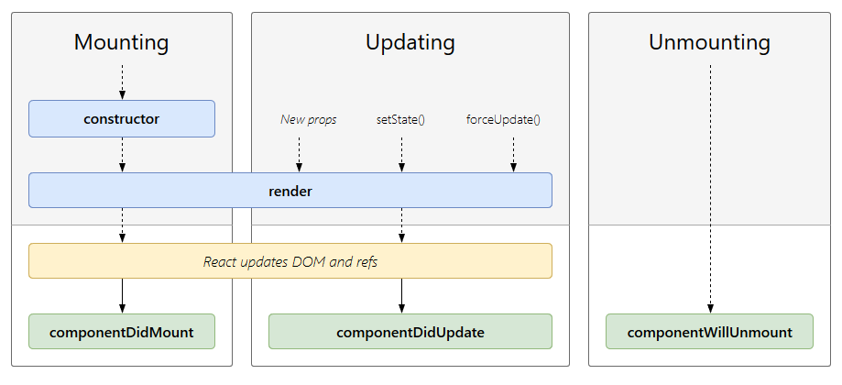
Component Lifecycle

Slide 18
Component Mounting
After preparing with basic needs, state and props a Component is ready to mount in the browser DOM
constructor
static getDerivedStateFromProps
render
componentDidMount

Slide 19
Component Updating
This phase starts with the beginning of the react component and expand by receiving new updates
static getDerivedStateFromProps
shouldCompoentUpdate
render
getSnapshotBeforeUpdate
componentDidUpdate

Slide 20
Component Unmounting
The component is not needed, and the component will get unmounted
componentWillUnmount
Here React does all the cleanups related to the component
Invalidating timers
Canceling network requests
Cleaning up any subscriptions

Slide 21


Higher-Order Components
Advanced Composition and Decoration

Slide 22
Higher-Order Components
A higher-order component (HOC) is an advanced technique in React for reusing component logic
HOCs are not part of the React API
HOC is a function that takes a component and returns a new component

Slide 23
Example: Reducer Function
A reducer applies a function over a sequence of elements to produce a single result
function reduce(arr, func) {
let result = arr[0];
for (let nextElement of arr.slice(1))
result = func(result, nextElement);
return result;
}
reduce([5, 10, 20], (a, b) => a + b); // 35
reduce([5, 10, 20], (a, b) => a * b); // 1000

Slide 24
Higher-Order Functions
Components are the primary unit of code reuse
Some patterns aren't straightforward for traditional components
Whereas as component transforms props into UI
HOC component transform a component into another component
const EnhancedComponent = higherOrderComponent(WrappedComponent);

Slide 25
HOC Example
Logging of component lifecycle events
function logged(WrappedComponent) {
return class extends React.Component {
componentDidMount() {
console.log(`${WrappedComponent.displayName} mounted`);
}
render() {
return <WrappedComponent {...this.props} />;
}
};
}

Slide 26

Advantages
Greater code reuse
Reduced boilerplate
Easily handle cross-cutting concerns
Commonly used for
Managing form input
Binding component props to business logic
Automating repetitive tasks

Slide 27

CSS Modules

Slide 28
CSS Modules
CSS files in which all class names and animation names are scoped locally by default
All URLs and imports are relative
Importing CSS Module from a JS Module
Exports an object with all mapping from local names to global names

Slide 29
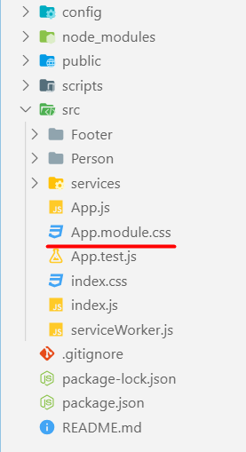
CSS Modules
React supports CSS Modules alongside regular stylesheet using the [name].module.css file naming convention
.App {
text-align: center;
}
.btn {
background-color: green;
color: white;
border-radius: 15px;
margin: 2%;
padding: 0.5%;
font-size: 24px;
cursor: pointer;
}

Slide 30
CSS Modules
CSS Modules let you use the same CSS class name in different file without worrying about naming clashes
.error {
background-color: white;
color: red;
}
CSS File called Button.module.css
import React, { Component } from 'react';
import styles from './Button.module.css';
class Button extends Component {
render() {
return <button className={styles.error}>Error Button</button>;
}
}
Importing all styles
Using error class from the css file

Slide 31

Using Fetch API
Fetching Remote Data

Slide 32
Fetch API
The Fetch API provides an interface for accessing and manipulating requests and responses
fetch() function which provides easy way to fetch resources asynchronously
functionality like this was previously achieved using XMLHttpRequest

Slide 33
Fetch API
fetch() takes one mandatory argument (the path to the resource you want to fetch)
second argument is optionally (init options - object)
returns a promise
once response is retrieved, there are several methods that defines what and how should be handled

Slide 34
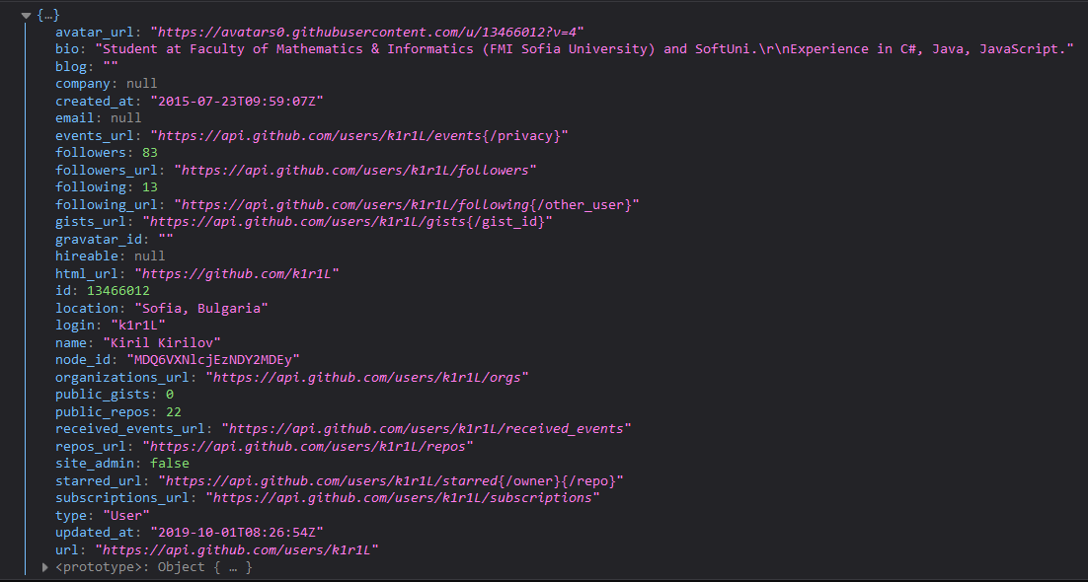
Fetch API
Fetch API with then/catch example
fetch('https://api.github.com/users/k1r1L')
.then((response) => response.json())
.then((myJson) => console.log(myJson))
.catch((myErr) => console.error(myErr));

Slide 35
Fetch API
Fetch API with async/await example
(async () => {
try {
const response = await fetch('https://api.github.com/users/k1r1L');
const myJson = await response.json();
console.log(myJson);
} catch (myErr) {
console.error(myErr);
}
})();

Slide 36
Fetch Services
The basic idea is to isolate the concern of fetching data inside components
Fetching data logic should separated as service
const apiUrl = '...';
export const getData = () => {
return fetch(apiUrl)
.then(res => res.json())
.then(data => data.results)
.catch(error => console.error(error))
};

Slide 37
Fetch Service
import { getData } from './services/fetching-data-service';
class App extends Component {
state = {
data: ...
};
componentDidMount() {
getData().then((data) => {
this.setState({ data })
});
}
render() { return ...;
}
}
Import the service
Using the service

Slide 38

Summary
Lists and Keys
Collection of components with unique key
Component Lifecycle
Mounting, Update and Unmounting
Higher-Order Component (HOC)
CSS Modules
Using the Fetch API
…
…
…

Slide 39
https://softuni.bg/opencourses/react-js

Slide 40












SoftUni Diamond Partners

Slide 41




SoftUni Organizational Partners

Slide 42




Trainings @ Software University (SoftUni)
Software University – High-Quality Education and Employment Opportunities
softuni.bg
Software University Foundation
http://softuni.foundation/
Software University @ Facebook
facebook.com/SoftwareUniversity
Software University Forums
forum.softuni.bg

Slide 43

License
This course (slides, examples, demos, videos, homework, etc.) is licensed under the "Creative Commons Attribution-NonCommercial-ShareAlike 4.0 International" license

